Slide 1

CS410 Project Report
Kevin Yu
I am Kevin Yu from Qingdao, China, and I formed a single person team due to some personal reasons when the project start.

Slide 2
About the Project
The plan of this project is to reproduce a paper called Latent Aspect Rating Analysis on Review Text Data: A Rating Regression Approach. And here is the quotation of the papers abstract:
Github Url: https://github.com/yukuo78/CourseProject
CMT Url: https://cmt3.research.microsoft.com/CS410Expo2020/Submission/Summary/124
…we define and study a new opinionated text data analysis problem called Latent Aspect Rating Analysis (LARA), which aims at analyzing opinions expressed about an entity in an online review at the level of topical aspects to discover each individual reviewer’s latent opinion on each aspect as well as the relative emphasis on different aspects when forming the overall judgment of the entity. We propose a novel probabilistic rating regression model to solve this new text mining problem in a general way. …

Slide 3
Structure of Program
Program is divided into three parts
Preprocessing: loading data from files and do some basic processing, generate vocabulary.
Aspect Segmentation: Use a bootstrapping method to find out aspect terms and distribute all sentences into different aspects.
LRR Model Regression: Estimate the model. (With restrictions of time and considering I only worked on this project alone, this section is only partially finished. )
Language: Python
Library | Description
numpy | For vector and matrix calculation.
nltk* | For some text preprocessing features.

Slide 4
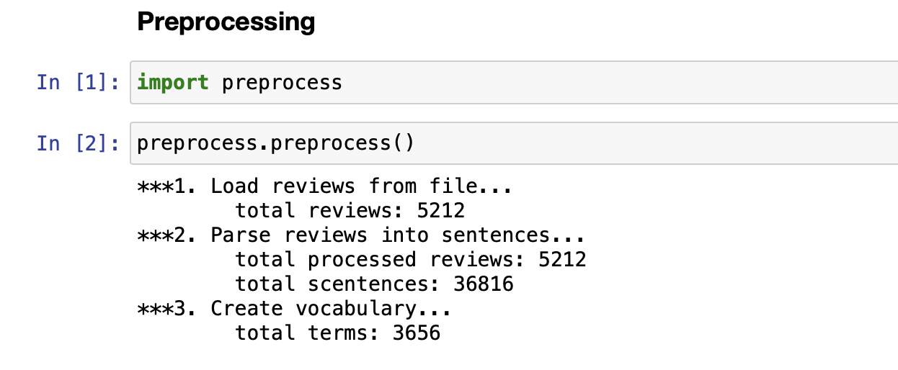
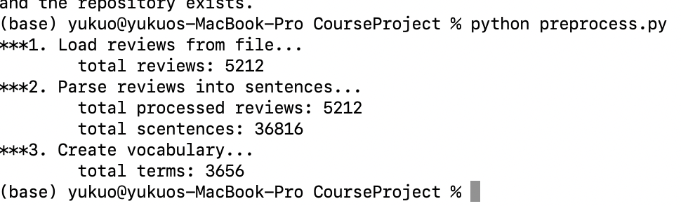
Preprocessing (preprocess.py)
Preprocessing: loading data from files and do some basic processing, generate vocabulary.
In this section performed below tasks:
Load hotel review data from file
Perform preprocessing tasks: lower case, remove stop word, stemming.
Build a vocabulary and a vocabulary dict.

Slide 5
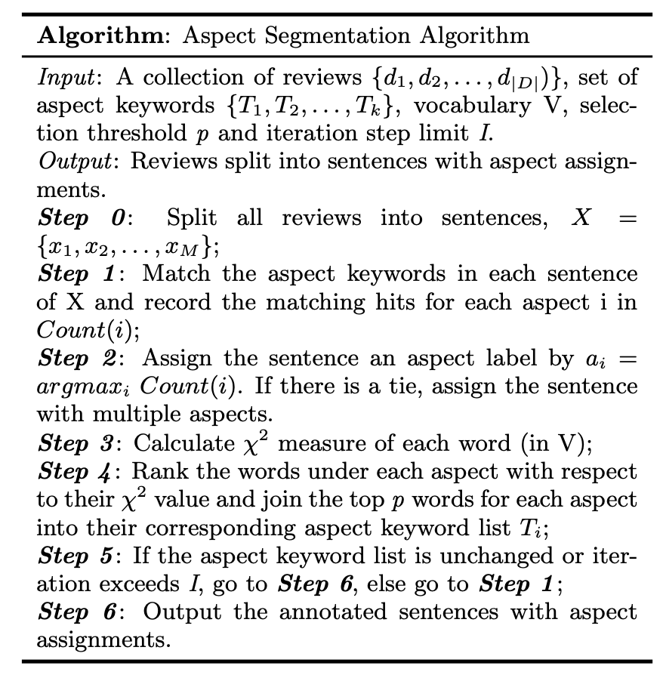
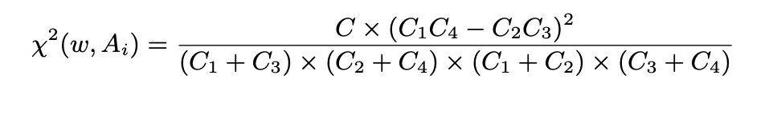
Aspect Segmentation (aspect_segmentaion.py)
Aspect Segmentation: Use a bootstrapping method to find out aspect terms and distribute all sentences into different aspects.
Load the minimum initial aspect terms, we predefined 7 aspects.
Calculate Chi square parameters as a K*V matrix
Add terms into aspects according to max Chi square value of each aspects.
Loop 10 iterations
The output of this phase is a considered the ground truth for the LRR model in the next step. I collected all needed data into a class named “Data”.

Slide 6
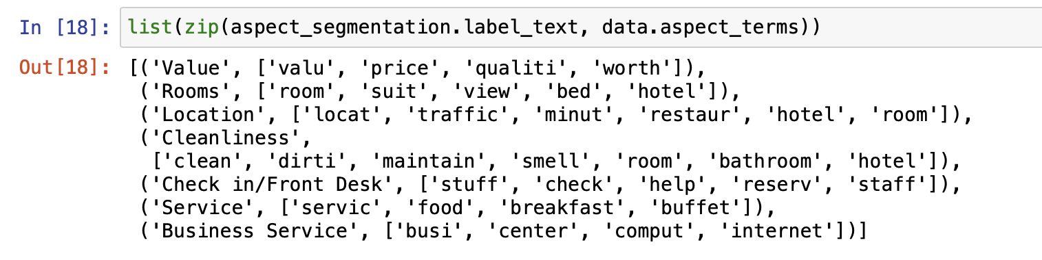
Aspect Segmentation (aspect_segmentaion.py)

Slide 7
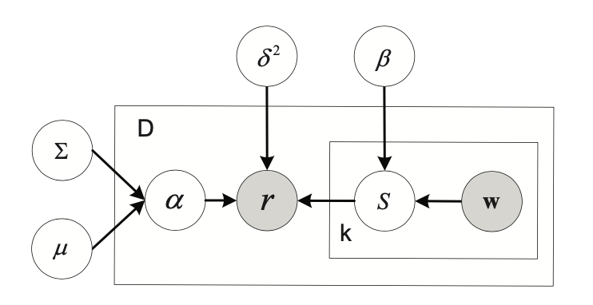
LRR Model Regression
With restrictions of time and considering I only worked on this project alone, this section is only partially finished.
Perform E step
Perform M step

Slide 8
What to do next?
Finish the Expectation Maximization implementation using gradient descent method.
Use the trained model to decompose reviews to find out laten aspect rating sand weights.
Notes:
In Slide Show mode, select the arrows to visit links.

